Slide 1
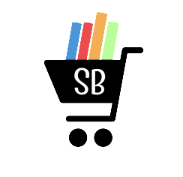
Shopping Buddy

Slide 2

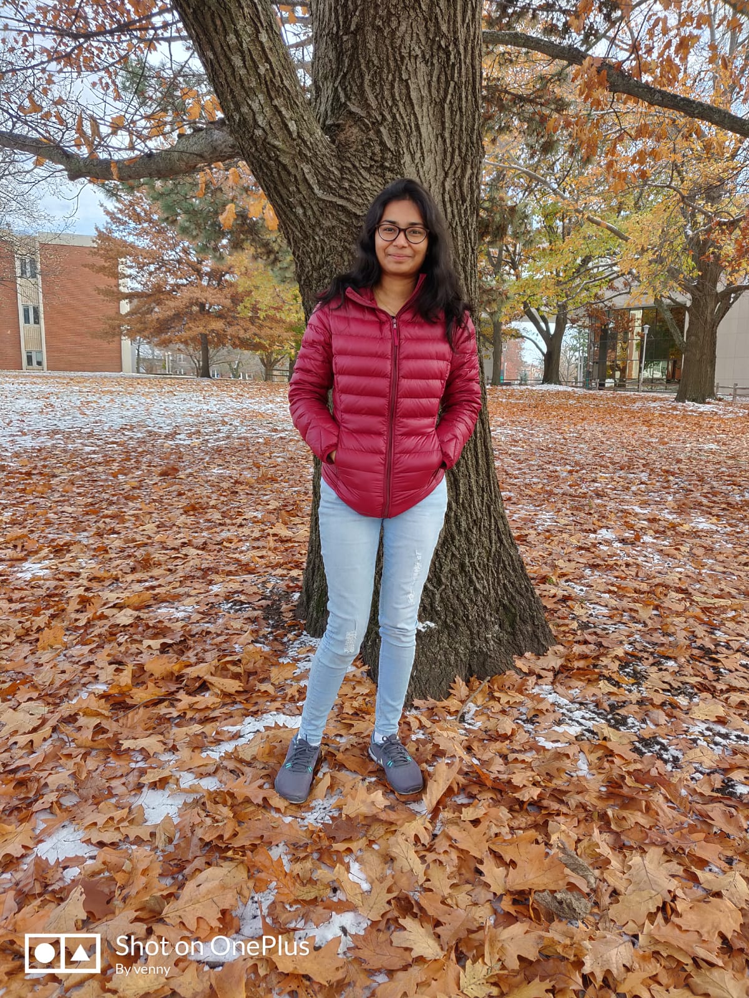
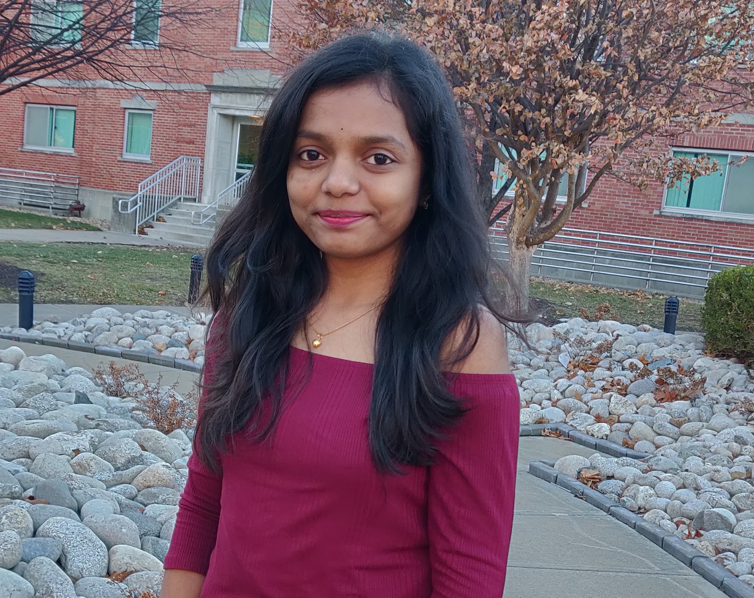



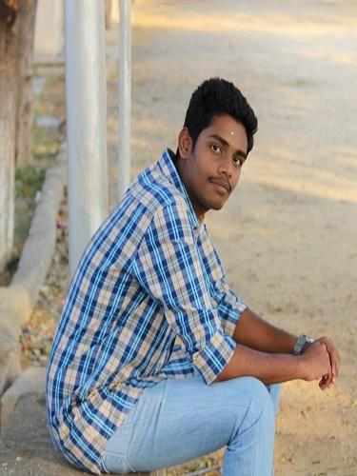
Yaswanth Yarram
Susritha Gade
Vennela Cheekoti
Mehar Choudhary Meenavilli
Rakesh Avirineni
Sathwika Gone
Sandeep Devineni

Slide 3
Agenda
Introduction
Tools and Technologies
Implemented Functionalities
Added Functionalities
Demo
Summary
Rakesh Avirineni

Slide 4
Introduction
The purpose of this project is to create a user friendly e-commerce application.
It helps the user in buying various products using internet.
This is an e-commerce application with a login screen, if the user is new to the application then they must register.
Rakesh Avirineni

Slide 5
User can browse through the different categories like clothing, household, furniture, etc. and can place their orders.
After placing the order the user will be navigated to the payment and once the payment is done user can see that their order is placed successfully.
Rakesh Avirineni

Slide 6

Tools and Technologies
Tools:
IDE: Android Studio
Database: Firebase
Repository: GitHub
Technologies:
Front-end: XML
Back-end: Java
Rakesh Avirineni

Slide 7
Implemented Functionalities
Rakesh Avirineni

Slide 8
Registration
Responsible: Rakesh Avirineni
Registration screen can be used by the novice user for registering into the application.
In this screen, the user needs to enter the username, contact number, e-mail, password and confirm the password for registration.
Rakesh Avirineni

Slide 9
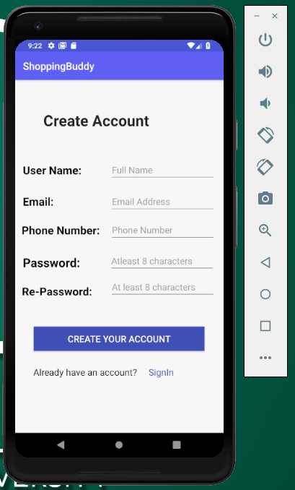
Registration screen
Rakesh Avirineni

Slide 10
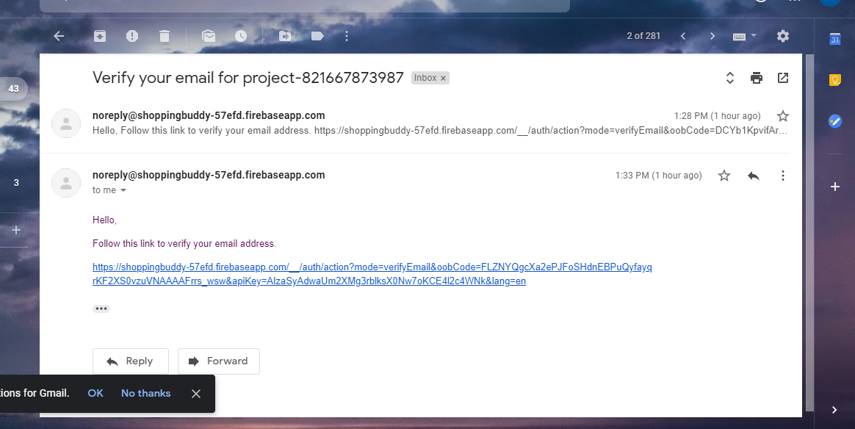
Email Authentication
User will get an verification link to their email. Before logging in to the application he/she must be verified through that link.
Rakesh Avirineni

Slide 11
Login
Responsible: Mehar Meenavilli
Login screen can be used by the registered user for logging into the application.
In this screen, the user must enter the username and password to get into the application.
This screen has a “Forgot Password” feature which leads the user to reset their password.
Mehar Meenavilli

Slide 12
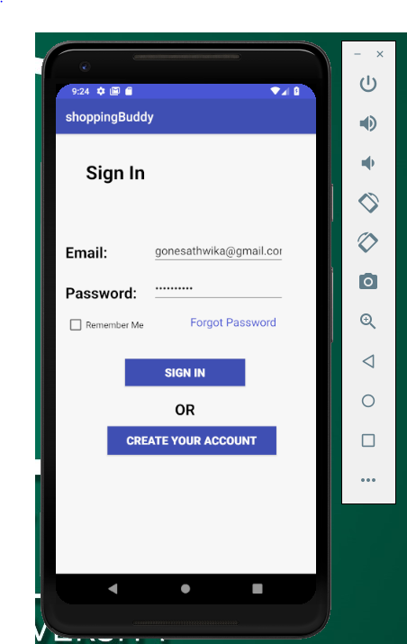
Login screen
Mehar Meenavilli

Slide 13
Forgot Password
Responsible: Mehar Meenavilli
Customers can use forgot password if they forget their password.
Customers can enter their registered email in the page and an email will be sent to the customer through which they can reset their password.
Mehar Meenavilli

Slide 14
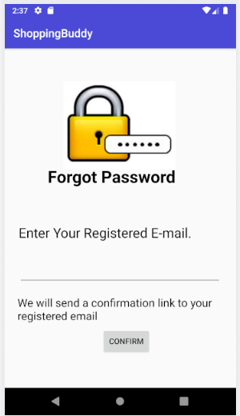
Forgot Password screen
Mehar Meenavilli

Slide 15
Menu(Admin)
Responsible: Rakesh Avirineni
Admin menu has navigation to History, Inventory and Settings pages.
Admin operations: Add product, View or Edit product, Add promo code and View or Edit promo code.
Rakesh Avirineni

Slide 16
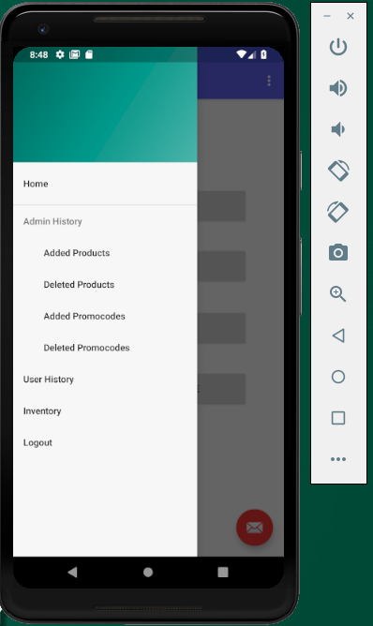
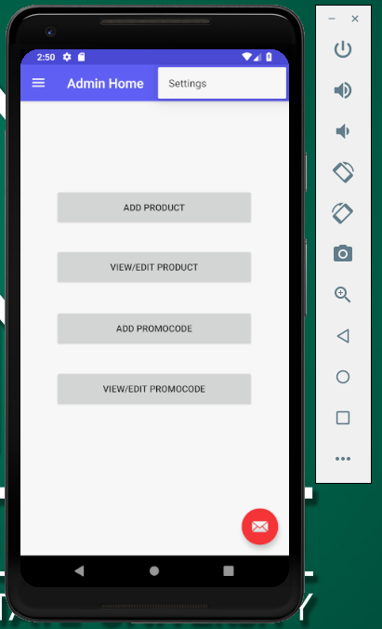
Menu(Admin) screen
Rakesh Avirineni

Slide 17
Add Product
Responsible: Vennela Cheekoti, Sathwika Gone
Admin can add product by filling all the details related to product like product id, product name, product description, product category, product cost and product image.
Sathwika Gone

Slide 18
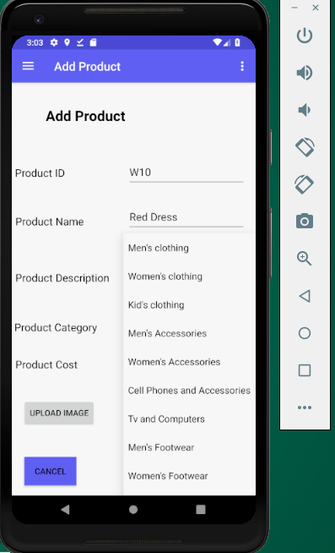
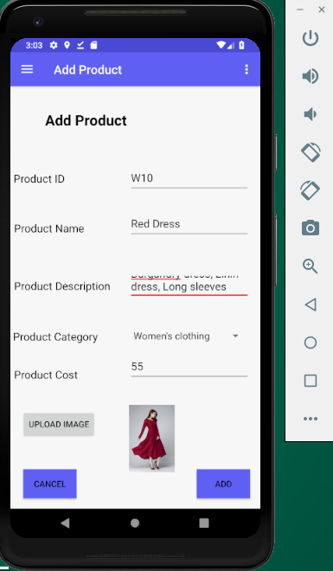
Add Product screen
Sathwika Gone

Slide 19
View/Edit Product
Responsible: Sathwika Gone, Vennela Cheekoti
To view the product admin should search the product based on category when he click on a particular product then he can edit or remove the product details.
Sathwika Gone

Slide 20
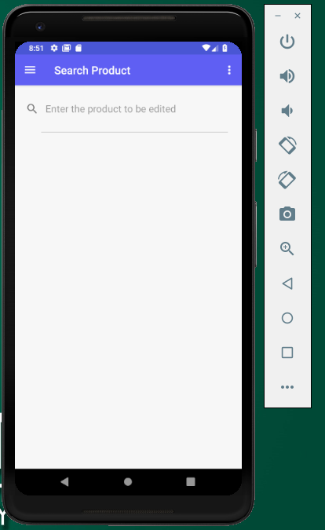
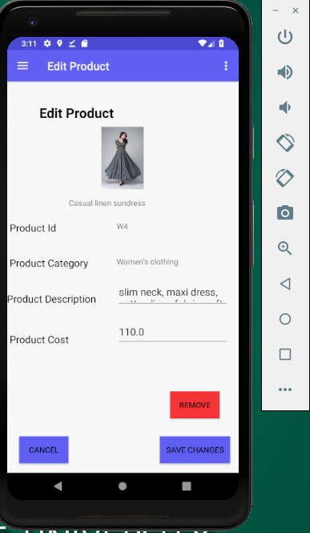
View/Edit Product screen
Sathwika Gone

Slide 21
Add Promo Code
Responsible: Sandeep Devineni
To add promo codes admin should enter promo code id, promo code and amount to be deducted.
Sandeep Devineni

Slide 22
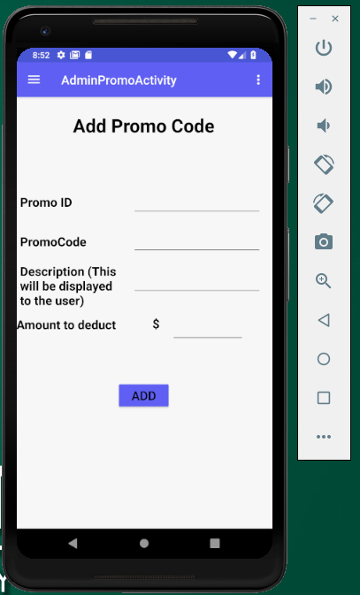
Add Promo code screen
Sandeep Devineni

Slide 23
Admin History
Responsible: Mehar Choudhary Meenavilli
Admin can view all the added/deleted products and added/deleted promo codes.
Mehar Choudhary

Slide 24
Admin History screen
Mehar Choudhary

Slide 25
User History
Responsible: Vennela Cheekoti
Admin can view all the products purchased by users
Vennela Cheekoti

Slide 26
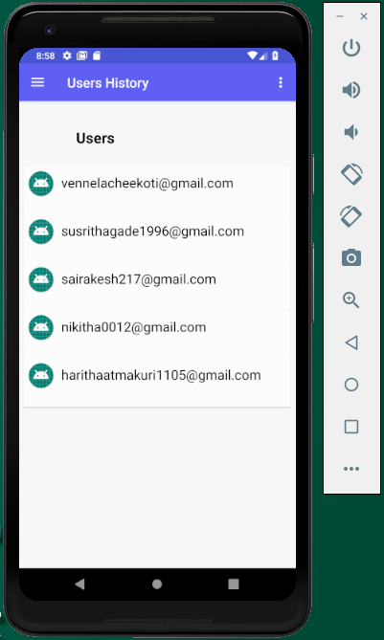
User History screen
Vennela Cheekoti

Slide 27
Settings
Responsible: Rakesh Avirineni, Sathwika Gone
Here admin can change their username and password.
Sandeep Devineni

Slide 28
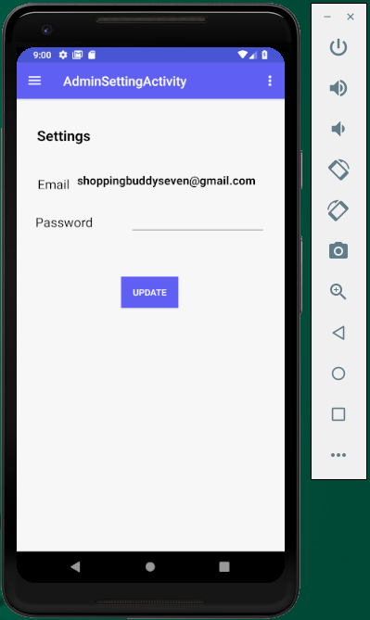
Settings screen
Sandeep Devineni

Slide 29
Inventory
Responsible: Susritha Gade
Admin can view all the products in the application.
Susritha Gade

Slide 30
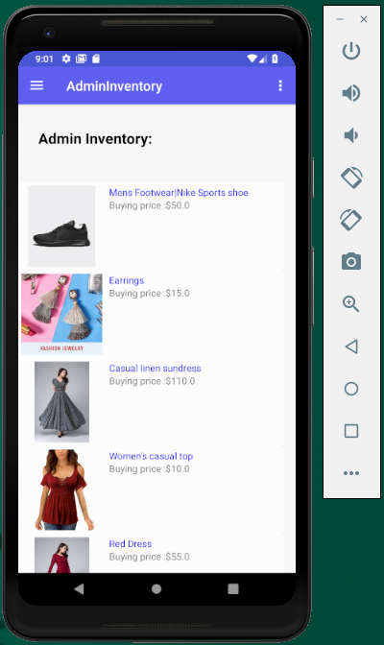
Inventory screen
Susritha Gade

Slide 31
Menu(user)
Responsible: Susritha Gade
User menu has navigation to different categories like clothing, footwear, accessories etc.
Susritha Gade

Slide 32
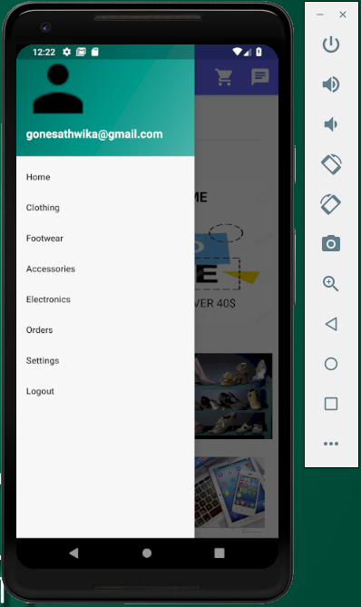
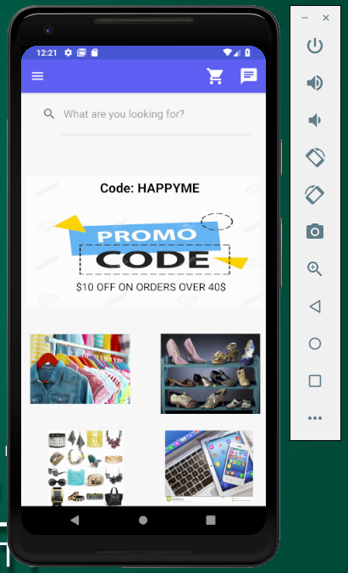
Menu(user) screen
Susritha Gade

Slide 33
Products List
Responsible: Susritha Gade
When the user clicks on a particular category he/she can view all the products related to the category that are added by the admin.
Susritha Gade

Slide 34
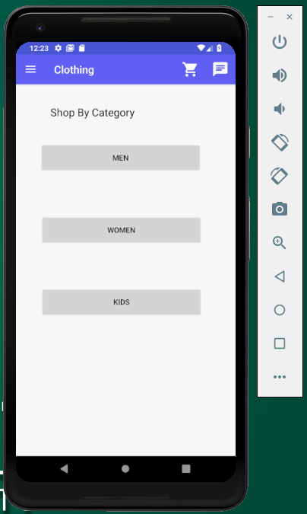
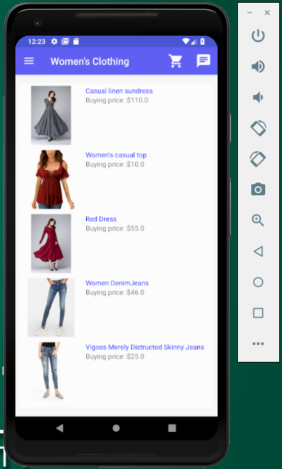
Products List screen
Susritha Gade

Slide 35
Product Details
Responsible:Yaswanth yarram, Rakesh Avirineni.
When a user click on a particular product he/she can view the product details like cost, image, sizes, description and quantity.
Yaswanth Yarram

Slide 36
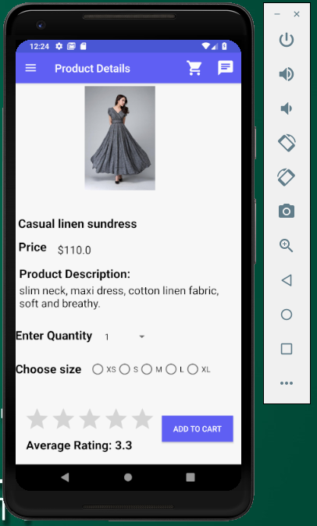
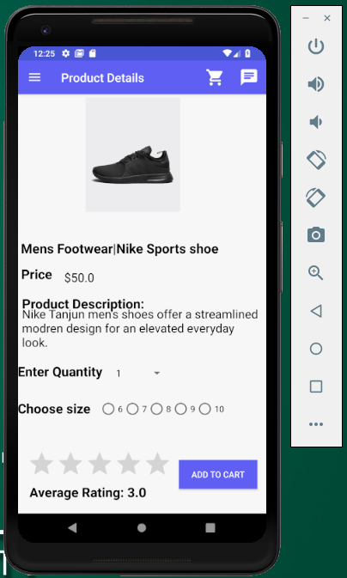
Product Details screen
Yaswanth Yarram

Slide 37
Cart
Responsible: Vennela Cheekoti.
In the cart screen we can view all the products added to the cart by the user. Here user can view the total cost of all the products.
Vennela Cheekoti

Slide 38
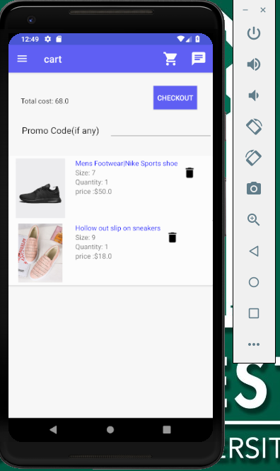
Cart screen
Vennela Cheekoti

Slide 39
Shipping Address
Responsible: Mehar choudhary, Rakesh Avirineni.
After clicking on the checkout button in the cart screen he/she can view the shipping address screen. Here the user should enter the address to which the products should deliver.
Mehar Meenavilli

Slide 40
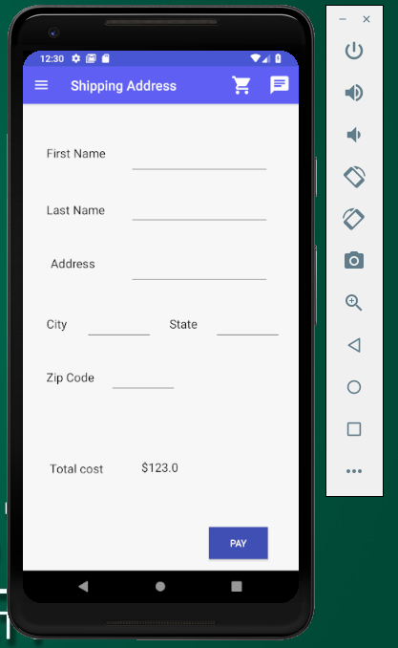
Shipping Address screen
Mehar Meenavilli

Slide 41
Payment
Responsible: Sathwika Gone.
Here the user must enter the card details to purchase the product.
Sathwika Gone

Slide 42
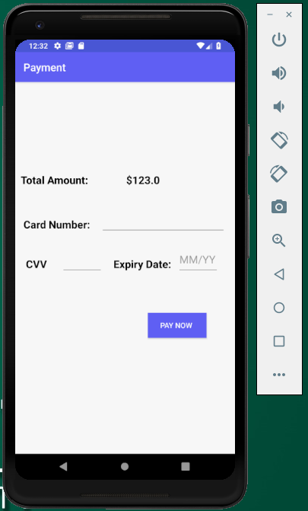
Payment screen
Sathwika Gone

Slide 43
Orders
Responsible: Sandeep Devineni.
User can view all the previous orders done by him/her and user can cancel or return the product.
Sandeep Devineni

Slide 44
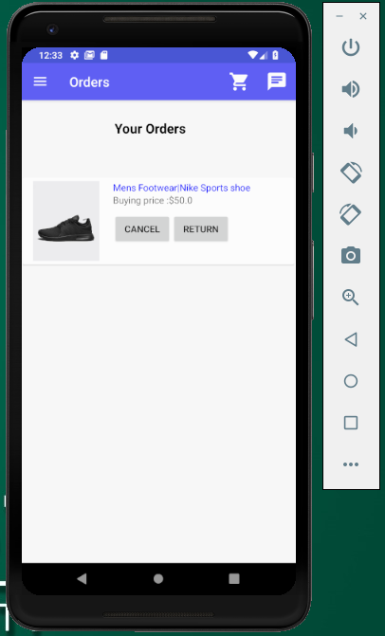
Orders screen
Sandeep Devineni

Slide 45
User Settings
Responsible: Yaswanth Yarram.
User can view their personal details like fullname, phone number and email id. They can edit these personal details. They can view the customer service email and phone number under contact us.
Yaswanth Yarram

Slide 46
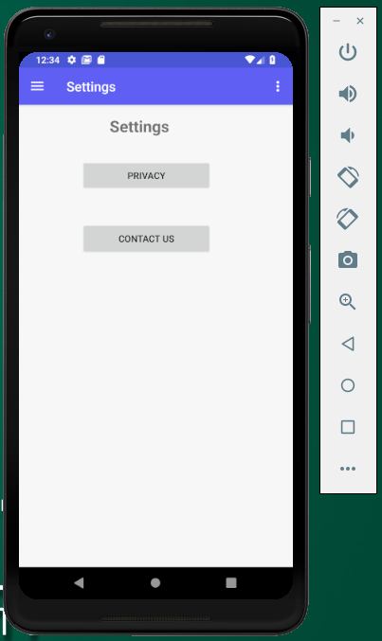
User Settings screen
Yaswanth Yarram

Slide 47
Contact us
Responsible: Susritha Gade, Vennela Cheekoti, Sathwika Gone.
The user can chat with the customer support.
Vennela Cheekoti

Slide 48
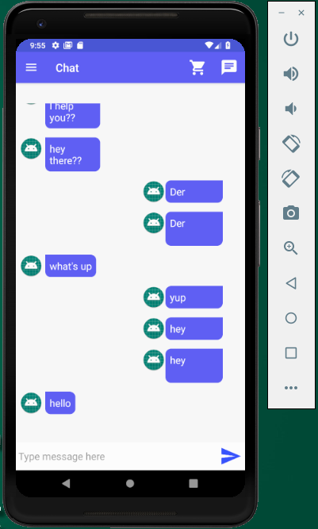
Contact us screen
Vennela Cheekoti

Slide 49
Ratings
Responsible: Mehar Meenavilli, Rakesh Avirineni, Yaswanth Yarram.
The user can give ratings to the products and an average rating of that product will be displayed.
Rakesh Avirineni

Slide 50
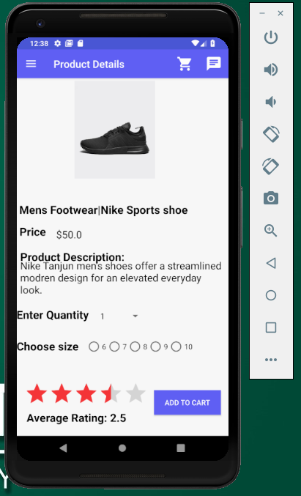
Ratings screen
Rakesh Avirineni

Slide 51
Added Functionalities

Slide 52
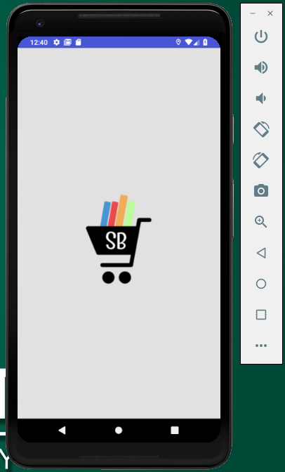
Splash Screen
This screen displays our app logo for 3 seconds before entering into the application.
Yaswanth Yarram

Slide 53
Remember me
By using remember me option user can login into the account easily.
User no need to type email and password every time they login into the account.
Yaswanth Yarram

Slide 54
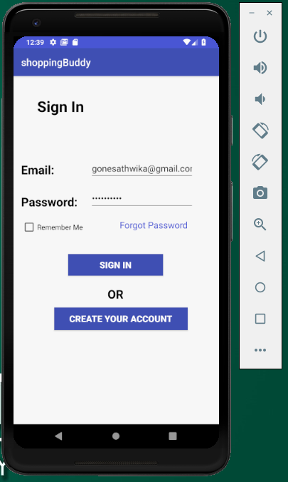
Remember me screen
Yaswanth Yarram

Slide 55
Search
User can search the product by typing in the search bar of the home page.
Susritha Gade

Slide 56
Summary
This is an e-commerce application where user can buy the products by viewing the description of the product and they can purchase it online by providing the address for shipment.
Susritha Gade

Slide 57
Yaswanth Yarram
Susritha Gade
Vennela Cheekoti
Mehar Choudhary Meenavilli
Rakesh Avirineni
Sathwika Gone
Sandeep Devineni

Slide 58


